Slide 1
Java arendaja õhtuõpe
GIT

Slide 2
Git
Git is a distributed version-control system for tracking changes in source code during software development. It is designed for coordinating work among programmers, but it can be used to track changes in any set of files. Its goals include speed, data integrity, and support for distributed, non-linear workflows.

Slide 3

Installi GIT
Kontrolli commandlines kas git töötab

Slide 4
Git
Command
git init | Create git repo
git status | Show current status
git add | Add to staging environment
git commit –m „commit message“ | Commit message
git branch | show branch info
git checkout new_branch | Switch to new_branch
git branch new_branch | Add new branch
git merge other_branch | Merge other_branch to curren branch

Slide 5
Git
Loo uus tühi kataloog
Ava command line
Kasuta cd käsklust, et liikuda command lines loodud kataloogi
Loo giti repo
Loo fail test.txt
Kirjuta test.txt faili sisse „ABCD“

Slide 6
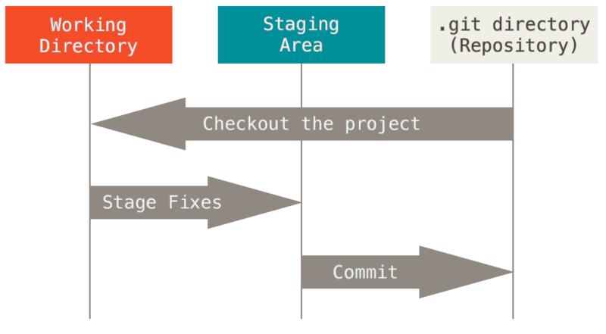
Git staging area

Slide 7
Git
Lisa test.txt staging areasse
Tee commit

Slide 8
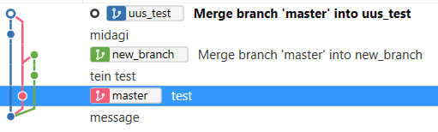
Harud

Slide 9
Git
Loo uus haru ja mine sinna harusse
Muuda test.txt sisu väikeste tähtedega
Tee add ja commit
Mine tagasi master harusse
Tee masteri failis test.txt ning lisa sinna mõned numbrid
Merge uus haru masterisse, vaata mis juhtub
Ava sama fail intellij

Slide 10
Git
https://git-scm.com/book/en/v2/Getting-Started-About-Version-Control

